Slide 1

AXI4 Asynchronous FIFO: Design and Verification using UVM
Department of Electronics & Communication Engineering
Project Work (22ECP175)
Feasibility Seminar
Batch No:A16
Bhavana G H 1BG22EC020
Manjunath C Shekar 1BG22EC051
Suhani S Basti 1BG22EC124
Guide:
Dr.Smitha Gayathri D
Associate Professor
BNMIT

Slide 2
Introduction
AMBA Evolution: On-chip communication in SoCs has evolved through APB → AHB → AXI under the AMBA (Advanced Microcontroller Bus Architecture) standard to address growing performance and scalability needs.
APB (Advanced Peripheral Bus): Designed for low-power, low-complexity control operations, mainly used for register accesses in peripherals. Its simplicity makes it efficient for configuration but unsuitable for large data transfers.
AHB (Advanced High-Performance Bus): Introduced pipelining, burst transfers, and multi-master support, making it suitable for high-bandwidth operations like DMA transfers. However, being a shared bus, it still suffered from contention and latency issues.
AXI (Advanced eXtensible Interface): Solved shared bus bottlenecks by introducing independent read/write channels, multiple outstanding transactions, and point-to-point interconnects (like a crossbar switch). This allows true parallelism and high throughput in modern

Slide 3
Objectives
To design a parameterized AXI4 Asynchronous FIFO that enables reliable data transfer between different clock domains while preserving AXI protocol integrity (tvalid, tready, tlast).
To Integrate AXI4 interface logic with the FIFO core to support packetized, high-throughput streaming data, along with flow-control and backpressure handling.
To develop a UVM-based verification environment to rigorously test the FIFO under directed and constrained-random scenarios, including varying packet sizes, backpressure, and clock ratios.
To validate the design using assertion-based checks and functional coverage, ensuring no data loss, no protocol violations, and robustness across edge cases (full, empty, overflow, underflow).
To demonstrate the project as a real-world, industry-relevant application by showing how AXI4-Stream FIFO supports high-performance SoC interconnects, achieving reliable, scalable, and reusable IP design.

Slide 4
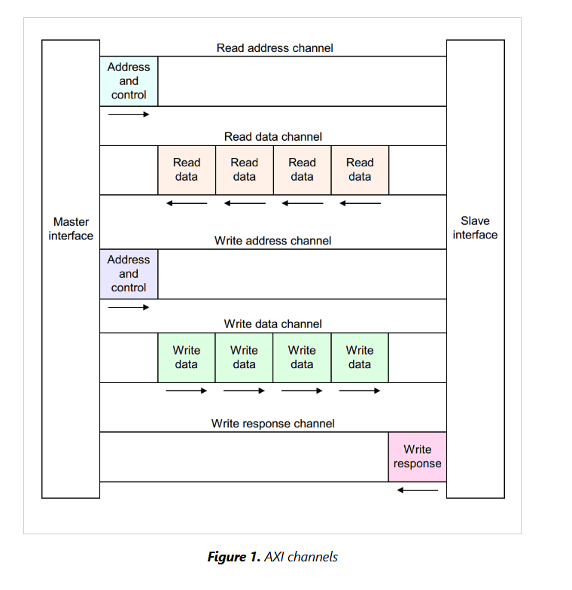
AXI Channels

Slide 5
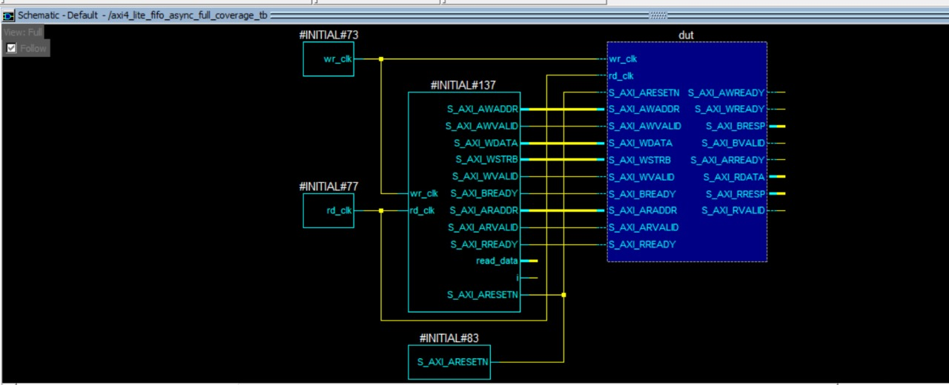
RESULTS
Top-Level Verification Setup: The diagram shows how the testbench environment connects to the DUT, including independent write/read clocks and asynchronous reset generation.
DUT Representation: The central axi4_lite_fifo_async block illustrates the core logic under test—AXI4-Lite interface + asynchronous FIFO.
Signal Connectivity: All AXI4-Lite channels (AW, W, B, AR, R) are clearly linked between the testbench and DUT, ensuring proper stimulus and response monitoring.

Slide 6
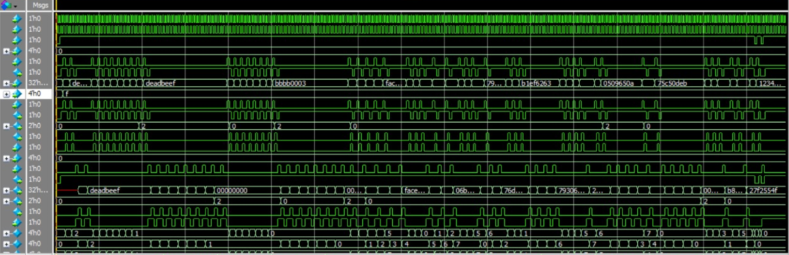
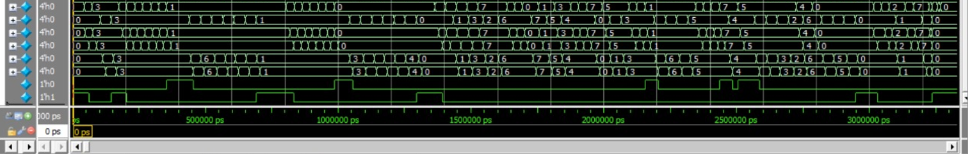
Top-Level Verification Setup: The diagram shows how the testbench environment connects to the DUT, including independent write/read clocks and asynchronous reset generation.
DUT Representation: The central axi4_lite_fifo_async block illustrates the core logic under test—AXI4-Lite interface + asynchronous FIFO.
Signal Connectivity: All AXI4-Lite channels (AW, W, B, AR, R) are clearly linked between the testbench and DUT, ensuring proper stimulus and response monitoring.

